Slide 1
food forecasting project
File created on: 20-01-2023 20:41:37

Slide 2
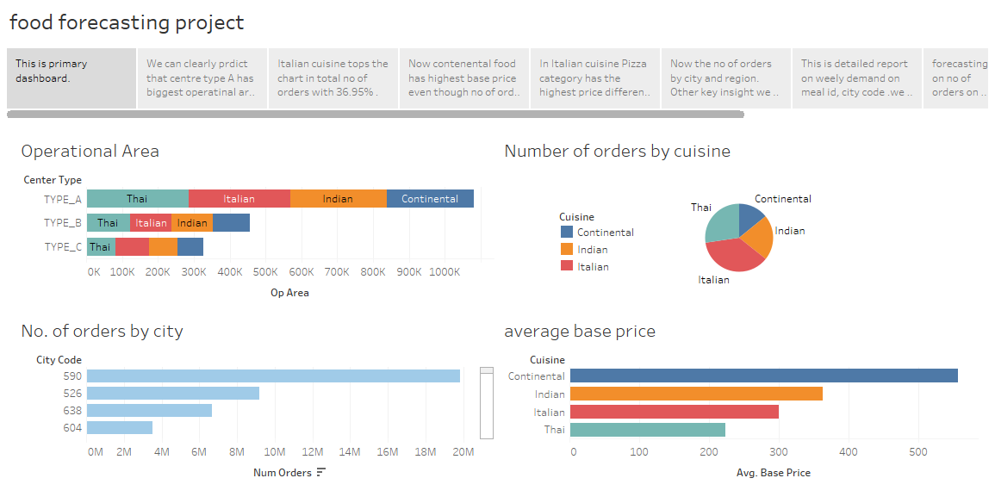

Slide 3
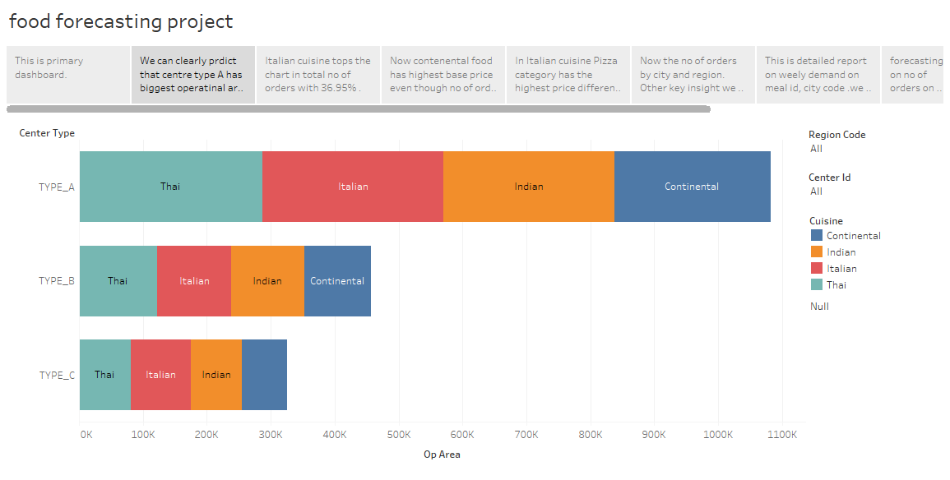

Slide 4
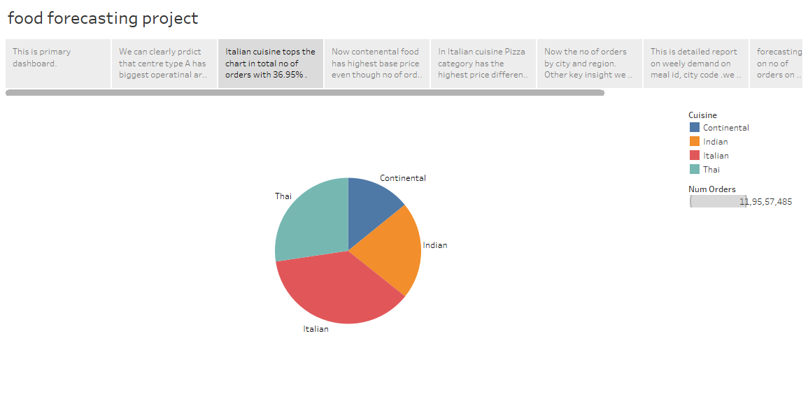

Slide 5
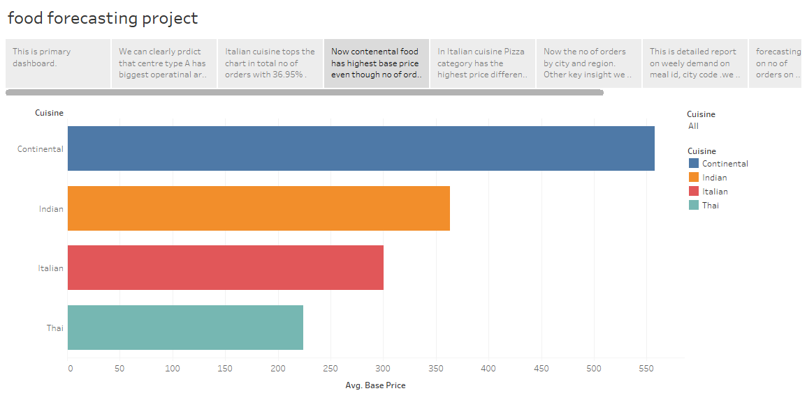

Slide 6
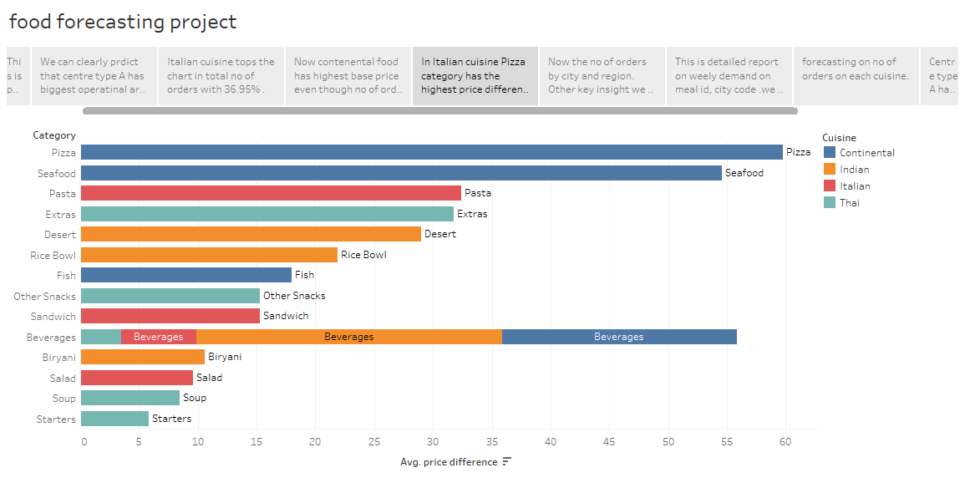

Slide 7
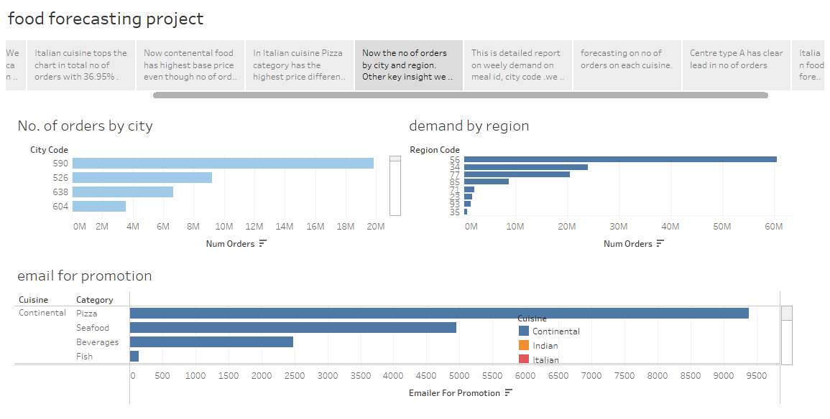

Slide 8
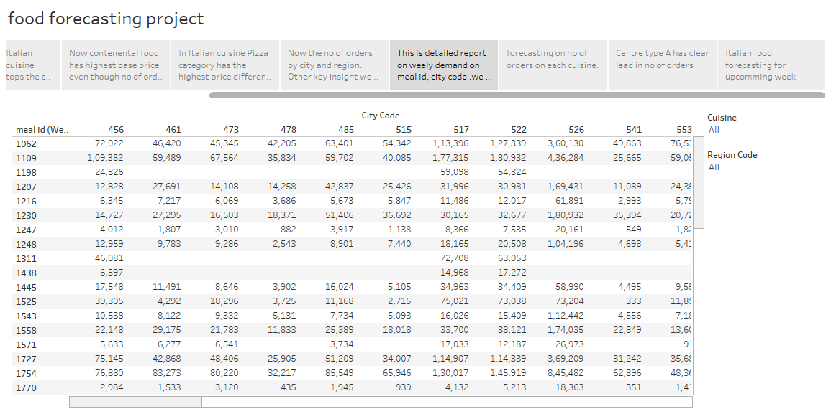

Slide 9
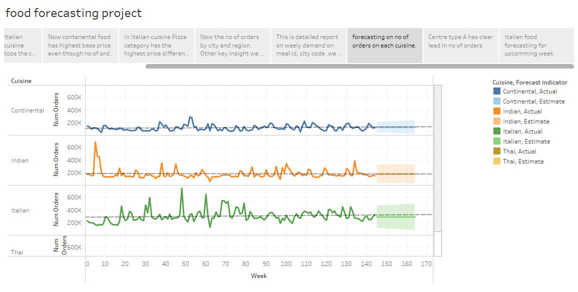

Slide 10
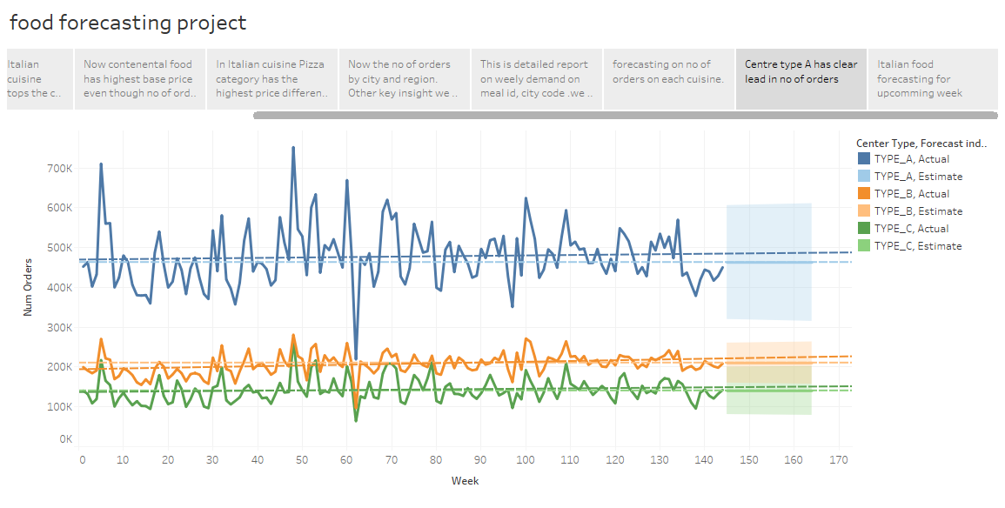

Slide 11
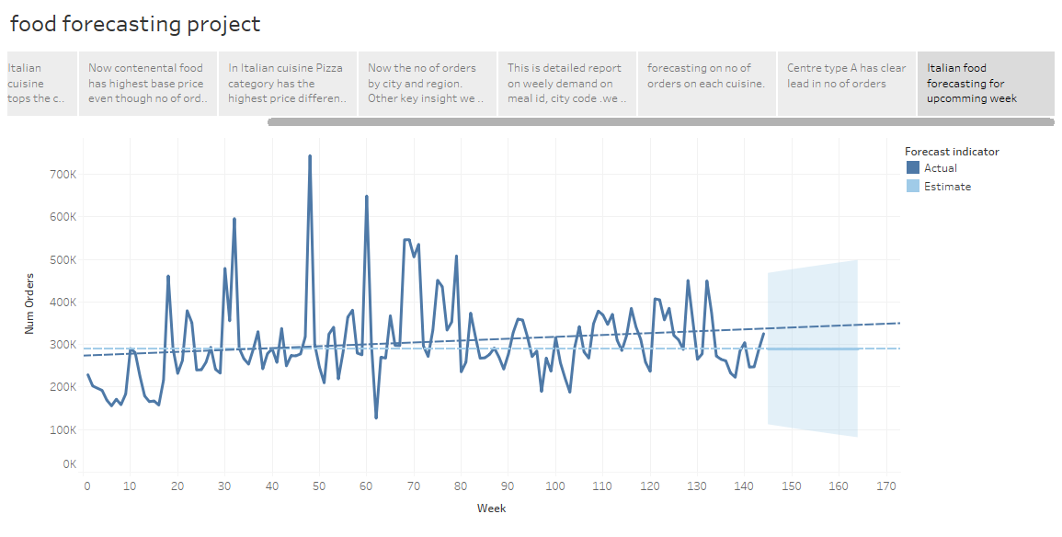

Slide 12
Summary
We can take various insights from this visual analysis of the food forecasting dataset. We have made a granular level analysis of this dataset. Key insights from this dataset are as follows-
We can see that Italian cuisine has the biggest market share of 36.95% followed by Thai, Indian and Continental respectively.
Centre type A has largest operational area with each type of cuisine as well.
We can clearly see that region 56 has highest no orders while region 35 and 93 has low number of orders. Which is a key insight that can followed to make some decisions.
Even though number of orders of Continental food is less their base price is highest among all cuisine, which is an interesting insight.
We have created a calculated field for price difference [Checkout Price]- [Base Price]. Which leads us to result that Pizza is the category having highest price difference among all the categories.
Again, an interesting insight is that continental foods emailer for promotion is highest.
We have some key insights for forecasting as well. Which predicts the demand in upcoming weeks on basis of No. of orders, Cuisines and category.
Conclusion:
We can add emailer for promotion in region 35 and 93.
We can minimize the price difference in Pizza category and increase in Thai Cuisine categories.
***

